Slide 1
LatentView Analytics
Campaign Management
Jan 2021

Slide 2
Agenda
1
Business Objective and Data Source
2
Campaign Management
3
Tool Wireframe

Slide 3
Business Objective and Data Source

Slide 4
Business Objective and Data Source
Business Context:
The main objective of this project is to model a target list of accounts with a high propensity to invest for specific funds. Generate a Target list using Past Engagement Behavior or Using predictive model
Identify the Potential Prospects of Client who are all interested in investing in a particular fund Through Email Campaign and identify prospects who are all having similar market share in IA sector.
Measure the campaign engagement performance by primary level (Email Campaign) and Secondary level (social, webcast and websites) and Measure the opportunities generated Through campaign engagement.
Measure total investments and compare investments through Campaign Marketing and Non – Marketing , measure the breakdown across top-up, cross sale and new clients.
Data Source:
Listed below data sources used for target audience list generation.
Interaction data (Prior Campaigns, Email, cases, events and Meetings Information)
Market Share data
Transactions data (SCV Cube)

Slide 5


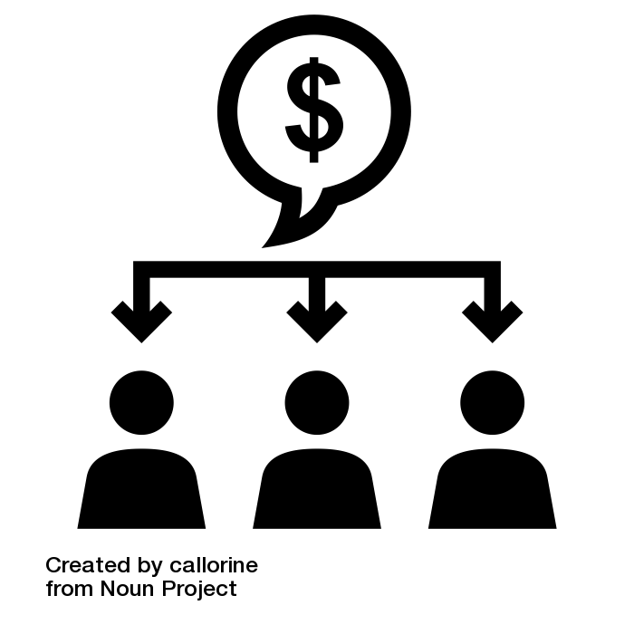
Campaign Management
Pre-Campaign: Generating a Target list of customers for campaign
Measure Engagement across multiple touchpoints to understand border impact of campaign
Measure Opportunities created and Breakdown Total Investments as Top-ups, Cross Sale and New Money
Generate a Target list using Past Engagement Behavior or Using predictive model
Primary and Secondary level Engagement to measure campaign engagement performance.
Measure the Total Investments and Compare Investment through campaign(Marketing) and investment generated without any marketing
Approach
Replicate data
Build a lookalike and predictive model
Measure primary/secondary level engagement
Measure Investment breakdown by marketing source
Build the tool Using R Shiny

Slide 6
Tool Wireframe

Slide 7
Pre-Campaign - Campaign Manager View
Target Audience: Campaign Management Team (Executive & Senior Executive level)
Objective:
Help a Campaign manager build a target list of prospects using indicators like - Past engagement behavior, past transaction behavior, RFM and Machine Learning model (Top 150 accounts Prospects)
Campaign Manager can also upload a Target list generated from their understanding of business.
Use a Machine Learning model to predict the potential engagement(Primary touchpoint i.e, Email) of a selected target list.
Questions:
Structure the Campaign by defining
What is the campaign about (which fund I am running the campaign for?)
How long should I run a Campaign?
How do i measure the success of this campaign (At what point I will start measure the success of a campaign)
Create a target list using past indicator of engagement behaviors
Who are we targeting based on past engagement behavior
Based on past engagement behavior how can I choose my target list?
Create a target list using past indicator of Transaction behaviors
Who are we targeting based on past transaction behavior and how can I choose my target list?
Based on similarity investment pattern with existing clients
Who are all the prospects with higher propensity to invest (based on how broad or targeted your campaign is pick the most likely set of prospects between 0 to 150)
Based on past Recency, Frequency and Monetary Value (size of transaction) Volume within the IA sector
Who are all the top prospect that I should target
Based on the target list selected for campaign process
How many prospects are more likely to engage and what is the potential engagement that I can except

Slide 8

Pre-Campaign - Campaign Manager View - 1
Period the Campaign Expected
Campaign Measurement Period
Fund
All
From
10-01-2020
To
01-02-2020
From
20-01-2020
To
01-04-2020
Structure the Campaign by defining -
Fund Chosen :
GARS
IA Sector :
Targeted List
Campaign Period :
10-01-2020 to 01-04-2020
Engagement Window :
10-01-2020 to 01-04-2020
#No of Existing Clients :
36
Summary
How long should I run a Campaign? (Time period of my campaign)
How do i measure the success of this campaign (At what point I will start measure the success of a campaign)
What is the campaign about (which fund I am running the campaign for?)
#Total Fund AUM :
1.2 mn
#Total IA Sector AUM (5% of Market):
1 bn
#No of Presently Engaged Contacts :
1036
Who are we targeting based on past engagement behavior
Based on past engagement behavior how can I choose my target list?
Choose between the target list that you want to build – either Custom or AI generated
How Can we Help?
I want to Build a Target List for My Campaign
I have a Target List I want to Track
Upload
Choose the past engagement behavior either by IA Sector level or Fund Level
Select Atmost/Atleast based on the matric value and select the aggregation window for last 12 Months/last 9 Months/last 6 Months/last 3 Months and Add to your list
Build Target List
Choose to Build either a custom target list or let us generate it for you
Custom
AI Generated
Both
Choose between the target list that you want to build – either you want to upload the target list or build your own target list
1. Campaign Responses
for past marketing in
IA Sector
For
At least
3
In
Last 6 Months
Add to List
2. Email Click Through
for past marketing in
IA Sector
For
At least
3
In
Last 6 Months
Add to List
3. Event Attendees
for past marketing in
IA Sector
For
At least
3
In
Last 6 Months
Add to List
Past Engagement Behavior
4. Cases
for past marketing in
IA Sector
For
At least
3
In
Last 6 Months
Add to List
5. Webcast
for past marketing in
IA Sector
For
At least
3
In
Last 6 Months
Add to List
6. Website
for past marketing in
IA Sector
For
At most
3
In
Last 6 Months
Add to List
7. Social
for past marketing in
IA Sector
For
At most
3
In
Last 6 Months
Add to List

Slide 9
Pre-Campaign - Campaign Manager View - 2
Period the Campaign Expected
Campaign Measurement Period
Fund
All
From
10-01-2020
To
01-02-2020
From
20-01-2020
To
01-04-2020
8. Do You want to run a Campaign for an existing client?
Yes
No
If Yes? What is the AUM for client in Fund >=
3000000
GBP
Add to List
9. Total Investment
in the
IA Sector
for the
Last 1 Year
Is
At least
20000
GBP
Add to List
10. Total Money Out
in the
IA Sector
for the
Last 1 Year
Is
At most
20000
GBP
Add to List
11. Switch In
in the
IA Sector
for the
Last 1 Year
Is
At least
20000
GBP
Add to List
Do you want to add your existing clients to the list
If Yes, Then what is the AUM for the client to target
Who are we targeting based on past transaction behavior and how can I choose my target list?
At most
12. Switch Out
In the
IA Sector
Last 1 Year
Is
20000
GBP
Add to List
Past Transaction Behavior
for the
13. Redemption
in the
IA Sector
for the
Last 1 Year
Is
At most
20000
GBP
Add to List
Based on similarity investment pattern with existing clients -
Who are all the prospects with higher propensity to invest (based on how broad or targeted your campaign is pick the most likely set of prospects between 0 to 150)
Wallet Size in IA Sector
Last 1 Year
20000
GBP
Add to List
Choose the Past Transaction Behavior either by IA sector level or Fund level
Select At most or At least based on the matric value and select the aggregation window for last 12 Months/last 9 Months/last 6 Months/last 3 Months and Add to your list
Total AUM with the Asset Manager Now (Our Client)
At least
20000
GBP
Add to List
Propensity to invest among Prospects
We recommend 150 Prospects based on their similar Investment pattern to existing clients
Depending on how broad or targeted your campaign is pick the most likely set of prospects.
47
Our Recommendations
0
Add the Selected 47 Prospects to your Target list
150
Add to my Target List

Slide 10
Pre-Campaign - Campaign Manager View - 3
Period the Campaign Expected
Campaign Measurement Period
Fund
All
From
10-01-2020
To
01-02-2020
From
20-01-2020
To
01-04-2020
Recency, Frequency & Transaction (RFM)
Based on the Recency, Frequency & Size of Transactions in IA-Sector Accounts have been Segmented
Depending on How Broad your Campaign is Pick the Following RFM, We have ranked the RFM from (1-5) (Please select from drop down list higher the values the better the result)
Based on the target list selected for campaign process,
How many prospects are more likely to engage and what is the potential engagement that I can except
Recency in Transactions
Frequency in Transactions
Size of Transactions (Monetary Value)
4
4
5
Includes Account who have done transaction in past four months
Includes Account has more frequent transaction in last 1 year
Includes Account has total transaction >= 25000 in last 1 year
Summary of Target list to export as CSV
Based on past Recency, Frequency and Monetary Value (size of transaction) Volume within the IA sector - Who are all the top prospect that I should target
Summary of Target List
Depending on how broad your campaign is pick the RFM values (Higher the values better the results)
More Likely to Engage
7500
Most Likely to Engage
5000
Account id | Account name | AUM (GBP) | Account Tier | Digital Touchpoints | With Past Engagement | Engagement Index | Investor Type | Forecasted Engagement Rate
1011 | ABC | Xxxx | 1 | Email, Website | Yes | High | Wealth Manager | 91
1012 | DEF | Xxxx | 1 | Webcasts | No | Medium | Bank | 60
1013 | GHI | Xxxx | 2 | Not Applicable | No | High | Insurance | 80
1014 | JKL | Xxxx | 3 | Website | Yes | High | Wealth Manager | 85

Slide 11
First Level Engagement View
Target Audience: Campaign Management Team (Executive & Senior Executive level)
Objective:
Measure the Primary level engagement (Email Engagement) Metric and Secondary level engagement (Social, Website and webcast) metric
Compare the Engagement through different target list generated (AI generated, Custom generated and Clients Target list uploaded)
Questions
Measure the success of my campaign
What is the engagement generated through primary source (through email)
What is the engagement generated through Secondary sources (through social, webcast & website)
Among the target list generated how can we compare which target list has higher engagement

Slide 12
First Level Engagement View
Campaign
Campaign name
Fund Chosen :
GARS
Compare the Engagement through different target list generated (AI generated, Custom generated and Clients Target list uploaded)
IA Sector Targeted Return
300 Million
Select the Campaign name to view the primary level engagement/Secondary level engagement
Summary
Campaign Period :
10-01-2020 to 01-04-2020
Engagement Window :
10-01-2020 to 01-04-2020
#No of Engagement:
14000
#No of Email Engagement:
11000
Target List Generated by tool
AI Generated
Total
Custom Generated List
Target List Uploaded
Information about the fund, Campaign Period, Engagement Window, IA sector Targeted return, No of engagement, No of email engagement
What is the engagement generated through primary source (through email)
What is the engagement generated through Secondary sources (through social, webcast & website)
# Total Engagement
7000
20%
5000
30%
2000
15%
14000
65%
Engagement by Category
#More Likely to Engage
2000
35%
2000
35%
1000
50%
5000
28%
#Most Likely to Engage
1750
25%
1750
25%
750
37%
4250
30%
Primary/Direct Engagement Generated (for Email Campaign)
Secondary Engagement Generated
#Sent
#Hardbounce
#Social Followers
#Social Response
We can measure the engagement happened through campaign on Social/Webcast/Website
Using these metrics, we can measure the engagement happened through email campaign
11000
100%
2000
5.5%
20000
100%
4000
20%
%Open rate
%Click Thru-Rate
#Website Visits
#Webcast Views
1650
15%
1320
12%
2000
2000

Slide 13
Campaign Success Measurement
Target Audience: Campaign Management Team (Executive & Senior Executive level)
Objective:
The Primary Objective of this view is to provide a campaign marketing funnel breakdown across various stages for the prospects targeted.
Breakdown investment in terms of promoted through Marketing and Non- Marketing by
Top Ups (existing investors in a product, topping up),
Cross Sell (Clients in other products, investing into the selected product for the first time) &
New money (Prospects who became new clients by investing in a fund).
Investment by capabilities view and gross sales happened in last 6 months and new opportunities created.
Questions:
How Successful is my campaign in driving the customer journey through marketing funnel
How does the investment through the campaign compared to the investments that we got through non-marketing channels
How has my campaign impacted overall investments across capabilities.

Slide 14
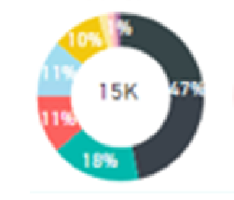
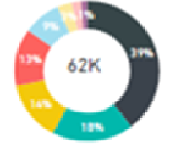
Campaign Success Measurement
Campaign Measurement Period
Campaign
Campaign name
Fund
GARS
Start date
20-01-2020
End date
20-04-2020
Investment by Capabilities
Sales by Capabilities
Choose Campaign name
How Successful is my campaign in driving the customer journey through marketing funnel?
Campaign Marketing Funnel breakdown (for prospect targeted)
How has my campaign impacted overall investments across capabilities?
#Engaged via Email :
11000
Choose the Start date and End date of a campaign to Measure its Success
#Sales/Opps Meeting :
7000
How does the investment through the campaign compared to the investments that we got through non-marketing channels?
#Early stage Opps :
3000
Objective of this view is to provide a campaign marketing funnel breakdown across various stages for the prospects targeted
Investments Happened Through Campaign – New Opps Created, Gross sale and Gross Redemption
#Later Stage Opps :
2000
Campaign Investment Breakdown
#Won Opps :
1000
Accounts that invested in fund
Total number of accounts that have invested in the fund for selected campaign period
3000
3bn
100%
Investment Through Campaign
Accounts that were existing investors, that topped up during the selected period
Promoted Through Marketing
Not Promoted Through Marketing
Investments of accounts promoted through Marketing activities
#New Opportunities over the Period of campaign
#Gross Sales over the period of campaign
Total sales happened in the selected campaign period
2000
2bn
70%
1000
1bn
30%
1000
20 Million
Top-up
Top-up
Accounts that were existing Client, that invested for the first time in the selected Product
900
900M
90%
1800
1.5bn
90%
Percentage Breakdown
Investments of accounts through non-promoted Marketing activities
Cross sale
#Gross Redemption over the period of campaign
Cross sale
100
25M
5%
50
50M
5%
New Clients that Invested for the first time in the selected product
50000
New clients
New clients
100
25M
5%
50
50M
5%

